Slide 1
A travel agent database
Yuhui Liu
12842201

Slide 2
1. Context
As traveling become more and more popular, it is common for people to choose a travel agent for big group traveling.
The travel agent arrange everything for customer.
Customer just need to go to the agent to choose which country and which trip they want to go, then the agent will arrange vehicle, restaurant, hotel and sightseeing for customer after the customer make payment.
A customer can book multiple trips. Reservation is what the customer orders for his or her trip
An employee can manage multiple reservations
There are different fixed traveling route for customer to choose
One traveling route have different schedules for days.

Slide 3
2. A travel agent database
employee
Manage
country
Employee_id
Name
Gender
Address
Contact_num
boss
route
Country_id
Country_name
has
Work for
Route_id
Route_type
Country_id *
Started_place
Destination
Vehicle_type
days
reservation
schedule
has
Route_id *
Schedule_id
Sightseeing_id *
Restaurant_id *
Hotel_id*
Reservation_id
Customer_id *
Employee_id *
Route_id *
Number_of_people
Date_of_reservation
Total_money
Payment_method
for
has
has
has
customer
Customer_id
Customer_name
Password
Email_address
birth
Contact_num
Address
hotel
restaurant
makes
sightseeing
hotel_id
country_id *
hotel_name
hotel_location
restaurant_id restaurant_name country_id*
resturant_location
sightseeing_id
sightseeing_name country_id *
location

Slide 4
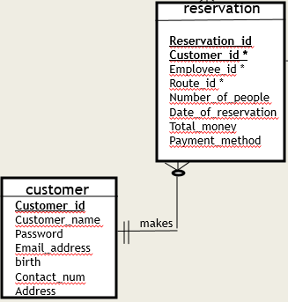
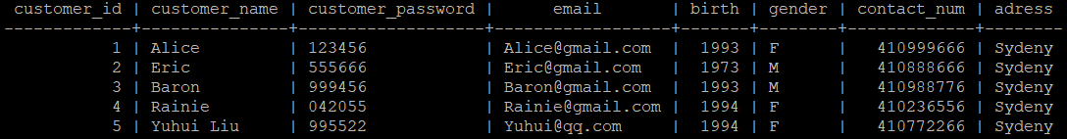
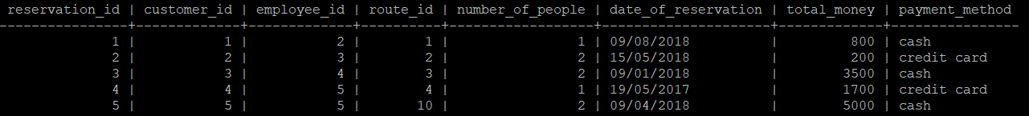
3. one-to-many relationship
Foreign key

Slide 5
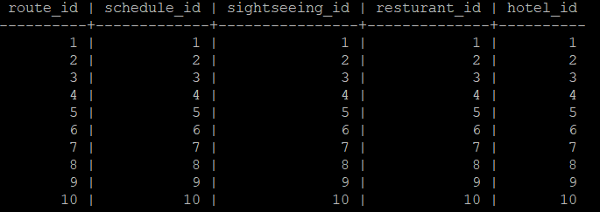
4. many-to-many relationship
hotel
hotel_id
country_id *
hotel_name
hotel_location
route
Route_id
Route_type
Country_id *
Started_place
Destination
Vehicle_type
days
schedule
has
has
Route_id *
Schedule_id
Sightseeing_id *
Restaurant_id *
Hotel_id*
sightseeing
has
sightseeing_id
sightseeing_name country_id *
location
has
restaurant
restaurant_id restaurant_name country_id*
resturant_location

Slide 6
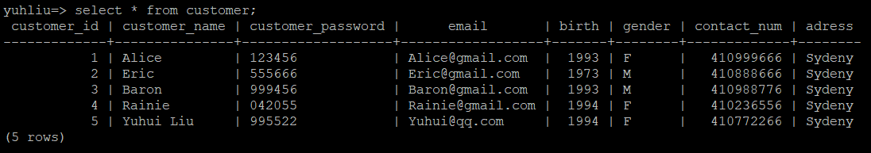
5.1A simple query of a single table. select * from customer;

Slide 7
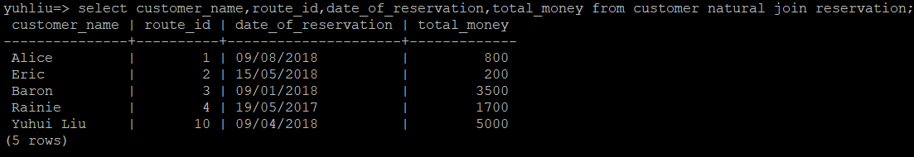
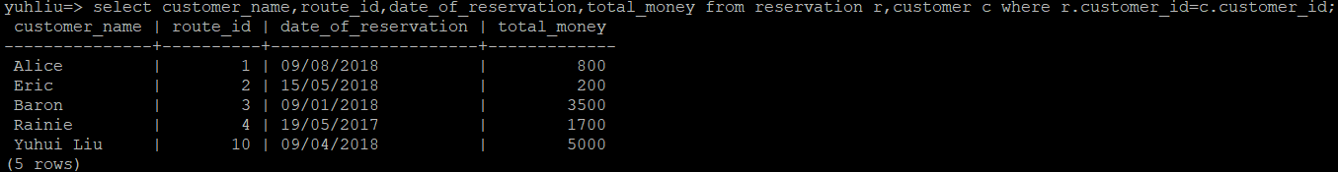
5.2 A query which uses the words "natural join".
select customer_name,route_id,date_of_reservation,total_money from customer natural join reservation;
5.3 The cross product equivalent to the "natural join" query above.
select customer_name,route_id,date_of_reservation,total_money from reservation r,customer c where r.customer_id=c.customer_id;

Slide 8
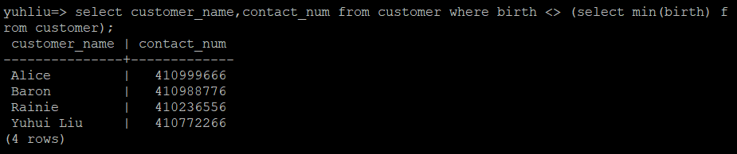
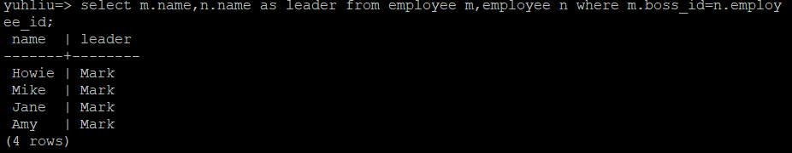
5.5 A query which uses a sub query.
/*select customer name and contact number expect the oldest one*/
select customer_name,contact_num from customer where birth <>( select min(birth) from customer);
5.6 A cross product which cannot be implemented using the words “natural join” -- employee--boss relationship table
select m.name as name, n.name as leader from employee m,employee n where m.boss_id=n.employee_id;

Slide 9
6. check statement
6.1 customer table
constraint birth check (birth >=1950 and birth<=2018) ------→check the customer is not too old, otherwise there is risks for old people travel outside.
constraint gender check(gender in ('M','F'))----→ check gender is male or female
constraint email check(email like '%%@%%') ----→ check email address is valid
6.2 route table
CONSTRAINT days CHECK (days > 0)----→ check the traveling route at least is bigger than 0 days
CONSTRAINT route_type CHECK (route_type in ('domestic', 'international'))---→check there are two types of traveling route. One is in Australia(domestic). The other one is out of Australia(international).
CONSTRAINT vehicle_type CHECK (vehicle_type in('train', 'plan', 'bus', 'cruise')---→check there are four types of transport tool to travel, which are train, plan, bus, cruise

Slide 10
6.3 reservation table
CONSTRAINT payment_method check (payment_method in('credit card','cash'))---→check there are two ways to pay for bills. One is paid by credit card. Another is paid by cash;
constraint total_money check(total_money>0)-→ at least the total money of the order is bigger than 0.
constraint number_of_people check(number_of_people>=1)--→ check there is at least one people in the reservation order.

Slide 11
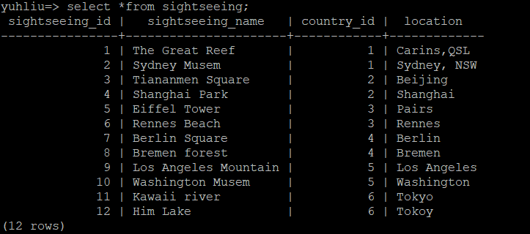
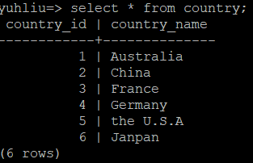
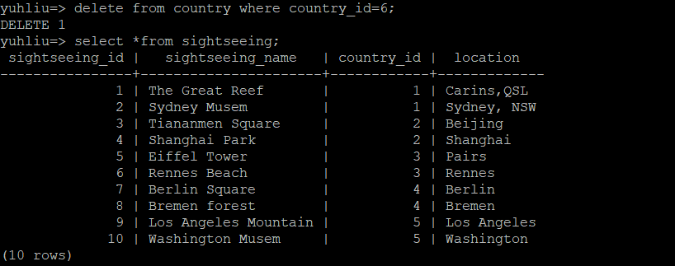
7. 1 ON DELETE CASCADE
REFERENCES country (country_id) ON UPDATE CASCADE ON DELETE CASCADE-----→if there is any changes or deletion in country table, the sightseeing table will follow the change
If we delete country 6(Japan), the result will be like below. The sightseeing table will update automatically.

Slide 12
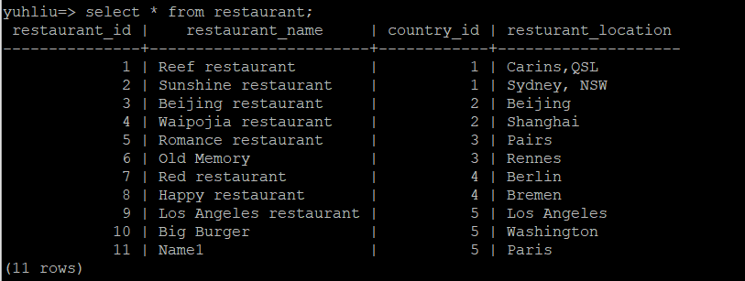
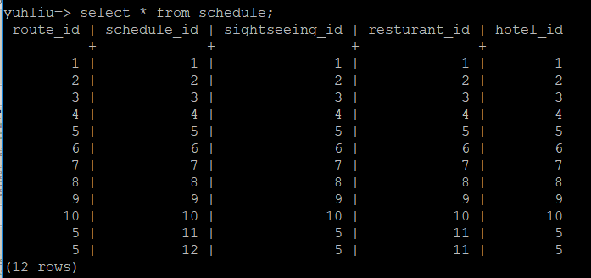
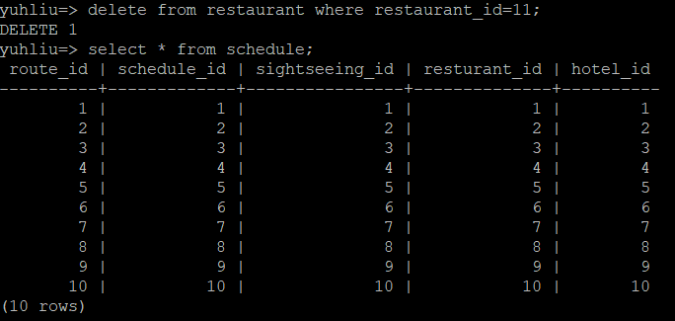
7.2 CONSTRAINT schedule_resturant_id_fkey FOREIGN KEY (resturant_id)
REFERENCES restaurant (restaurant_id) ON UPDATE CASCADE ON DELETE CASCADE
After delete ‘name1’ from restaurant table.

Slide 13
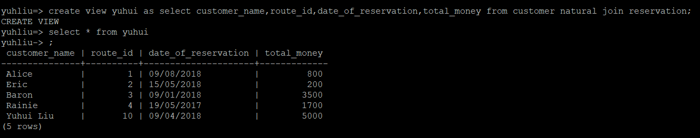
8. Creat view table
create view yuhui as select customer_name,route_id,date_of_reservation,total_money
CREATE VIEW
yuhliu=> select * from yuhui;

